Slide 1

GENDER AND AGE DETECTION USING DEEP LEARNING
GULSHIR ANSARI (MU18BTCSE016)
SHAMSHER ALAM (MU18BTCSE011)
GUIDED BY
MR SATISH KUMAR DUBEY.
ASSOCIATE PROF
DEPARTMENT OF COMPUTER SCIENCE & ENGINEERING
8TH SEMESTER

Slide 2
CONTENT
AIM OF THE PROJECT
INTRODUCTION
PROJECT METHODOLOGY
FLOW CHART
FEATURE
TECHNOLOGIES USED
SOFTWARE/HARDWARE REQIRED
FUTURE SCOPE OF OUR PROJECT
REFRENCES

Slide 3
AIM OF THE PROJECT
To build a gender and age detector that can approximately guess the gender and age of the person (face) in a picture using Deep Learning on the Audience dataset

Slide 4
INTRODUCTION
Age and gender, two of the key facial attributes, play a very foundational role in social interactions, making age and gender estimation from a single face frame is an important task in intelligent applications, such as access control, human-computer interaction, law enforcement, marketing intelligence and visual surveillance, etc.
In this project, a frame is taken as input and the algorithm will determine the age and gender of person(s) in the frame. We divide the age into 8 ranges[(0-2), (4-6), (8-12), (15-20), (23-27), (28-32), (36-40), (44-52)] and the output age will fall into one of them. While, the gender will be either male or female.

Slide 5
Methods for Age and Gender detection
In this project we implemented a method using OpenCV to detect the Gender and Age of a person using their image. You can also live detect your Gender and Age using Web camera by running this code using Python IDLE.
Objectives :-
Detect faces
Classify into Male/Female
Classify into one of the 8 age ranges
Put the results on the image and display it

Slide 6
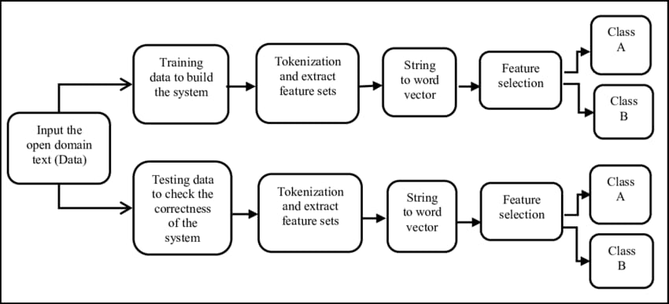
METHOD

Slide 7
FLOW CHART
Start
Image
Acquisition
Face
Detection
Feature Extraction
Convolution Neural Network
Trained Database
Support Vector
Machine
Final Output
(Display)

Slide 8
FEATURE
AI based Age and Gender Detection.
Can be integrated with existing surveillance setup.
Face Recognition API to identify the employee, contract, staff, worker etc.
Real time Report

Slide 9
TECHNOLOGIES USED
OpenCV
OpenCV is Open Source Computer vision. This library is capable of processing real-time frame and video while also boasting analytical capabilities OpenCV is used to display text on the picture using putTexto.

Slide 10
2.CONVOLUTIONAL NEURAL NETWORKS(CNN)
A Convolutional Neural Network is a deep neural network (DNN) widely used for the purposes of frame recognition and processing and NI.P. Also known as a ConvNet, a CNN has input and output layers, and multiple hidden layers, many of which are convolutional. In a way, CNNs are regularized multilayer perceptrons.

Slide 11
3. TENSORFLOW
TensorFlow is an end-to-end open source platform for machine learning. TensorFlow is a rich system for managing all aspects of a machine learning system. TensorFlow allows developers to create dataflow graphs-structures that describe how data moves through a graph, or a series of processing nodes.

Slide 12
SOFTWARE AND HARDWARE REQUIREMENT​
Software:
Operating system : Window 10 etc.
Hardware:
4 GB / 8 GB Ram
Camera
Processor Intel CORE i3 And Above
Graphics Card 2GB
Monitoring screen

Slide 13
Scope for Future Work
For future works, we will consider a deeper CNN architecture and a more robust image processing algorithm for exact age estimation. Also, the apparent age estimation of human’s face will be interesting research to investigate in the future.

Slide 14
REFERENCES
A. Krizhevsky, I. Sutskever, and G. E. Hinton, “Imagenet classification with deep convolutional neural networks,” in Advances in neural information processing systems, 2012, pp. 1097–1105.
O. M. Parkhi, A. Vedaldi, and A. Zisserman, “Deep face recognition,” 2015.
S. E. Bekhouche, A. Ouafi, A. Taleb-Ahmed, A. Hadid, and A. Benlamoudi, “Facial age estimation using BSIF and LBP,” 2014, https://arxiv.org/abs/1601.01876.View at: Google Scholar
A. Günay and V. Vasif, “Age estimation based on AAM and 2D-DCT features of facial images,” International Journal of Advanced Computer Science and Applications, vol. 6, no. 2, pp. 113–119, 2015.View at: Publisher Site | Google Scholar

Slide 15
THANK YOU

